Slide 1
3D Image Segmentation and Quantification of Lysosomes
20/10/2025

Slide 2
3D Image Segmentation of Lysosomes
🧫 Identify and measure lysosomes
in 3D cell images.
📊 Quantify number, size, and localization
per cell.
🎯 Assign each lysosome to a cell
territory using watershed mapping.

Slide 3
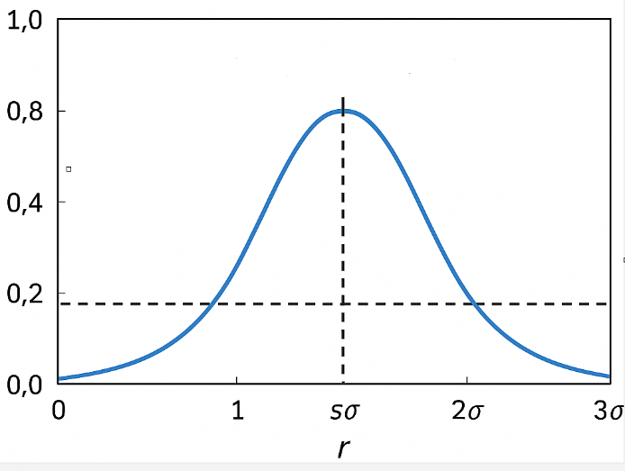
How We Measure Lysosome Size
1️Detect bright spots → potential lysosomes.
2 Find best-fit scale (sigma) per spot.
3 Convert to radius: radius ≈ FACTOR × scale.
4 Calculate diameter and volume.
It is a factor comes from how spot detection algorithms in 3D microscopy (such as the Laplacian of Gaussian or Difference of Gaussians filters) relate the detected “scale” (σ) of a spot to its physical radius in voxel or micrometer units.

Slide 4
How We Find the Cells
🔍 Filter: highlights neurite-like
structures.
⚙Local thresholding: adapts
to brightness variation.
🧹 Cleanup: remove noise and
fill gaps for continuous cells.

Slide 5
Topographic Map: Watershed Segmentation
🏔 Bright regions = hills (cell bodies), dark = valleys (background).
💧 Flood from each cell center until borders meet.
📍 Each pixel assigned to one cell → lysosomes labeled by cell ID

Slide 6
Summary
✨ Pipeline overview: spot detection → cell segmentation
→ labeling.
📈 Extract metrics: lysosome count, size, and spatial distribution.
💡 Visualization-ready for 3D cell analysis and comparison.

Slide 7
FILES
Airy scan_40A_UAS-TMEM-HA_CB_0h_1_051222
Airy scan_40A_UAS-TMEM-HA_CB_0h_2_051222
Airy scan_40A_UAS-TMEM-HA_CB_4h_1_051222
Airy scan_40A_UAS-TMEM-HA_CB_4h_2_051222
40A_UAS-TMEM192-3xHA x 40A 71G10 MARCM_around 12h - for quantification_3 Airy-CBs_300425
40A_UAS-TMEM192-3xHA x 40A 71G10 MARCM_around 12h - for quantification_4 Airy-CBs_300425
40A_UAS-TMEM1923x-HA x 71G10 40A MARCM_L3_1_Airy_010724
40A_UAS-TMEM1923x-HA x 71G10 40A MARCM_L3_2_Airy_010724

Slide 8
Airy scan_40A_UAS-TMEM-HA_CB_0h_1_051222

Slide 9
Airy scan_40A_UAS-TMEM-HA_CB_0h_1_051222

Slide 10
Airy scan_40A_UAS-TMEM-HA_CB_0h_2_051222

Slide 11
Airy scan_40A_UAS-TMEM-HA_CB_0h_2_051222

Slide 12
Airy scan_40A_UAS-TMEM-HA_CB_4h_1_051222

Slide 13
Airy scan_40A_UAS-TMEM-HA_CB_4h_1_051222

Slide 14
Airy scan_40A_UAS-TMEM-HA_CB_4h_2_051222

Slide 15
Airy scan_40A_UAS-TMEM-HA_CB_4h_2_051222

Slide 16
40A_UAS-TMEM192-3xHA x 40A 71G10 MARCM_around 12h - for quantification_3 Airy-CBs_300425

Slide 17
40A_UAS-TMEM192-3xHA x 40A 71G10 MARCM_around 12h - for quantification_3 Airy-CBs_300425

Slide 18
40A_UAS-TMEM192-3xHA x 40A 71G10 MARCM_around 12h - for quantification_4 Airy-CBs_300425

Slide 19
40A_UAS-TMEM192-3xHA x 40A 71G10 MARCM_around 12h - for quantification_4 Airy-CBs_300425

Slide 20
40A_UAS-TMEM1923x-HA x 71G10 40A MARCM_L3_1_Airy_010724

Slide 21
40A_UAS-TMEM1923x-HA x 71G10 40A MARCM_L3_1_Airy_010724

Slide 22
40A_UAS-TMEM1923x-HA x 71G10 40A MARCM_L3_2_Airy_010724

Slide 23
40A_UAS-TMEM1923x-HA x 71G10 40A MARCM_L3_2_Airy_010724

